Slide 1
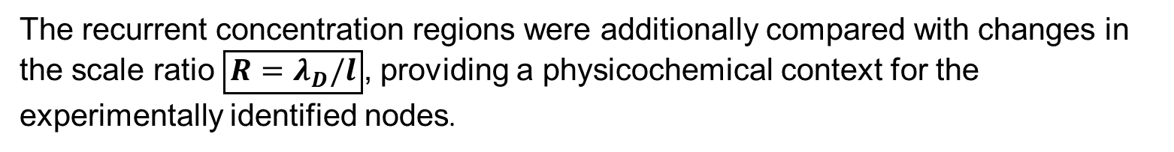
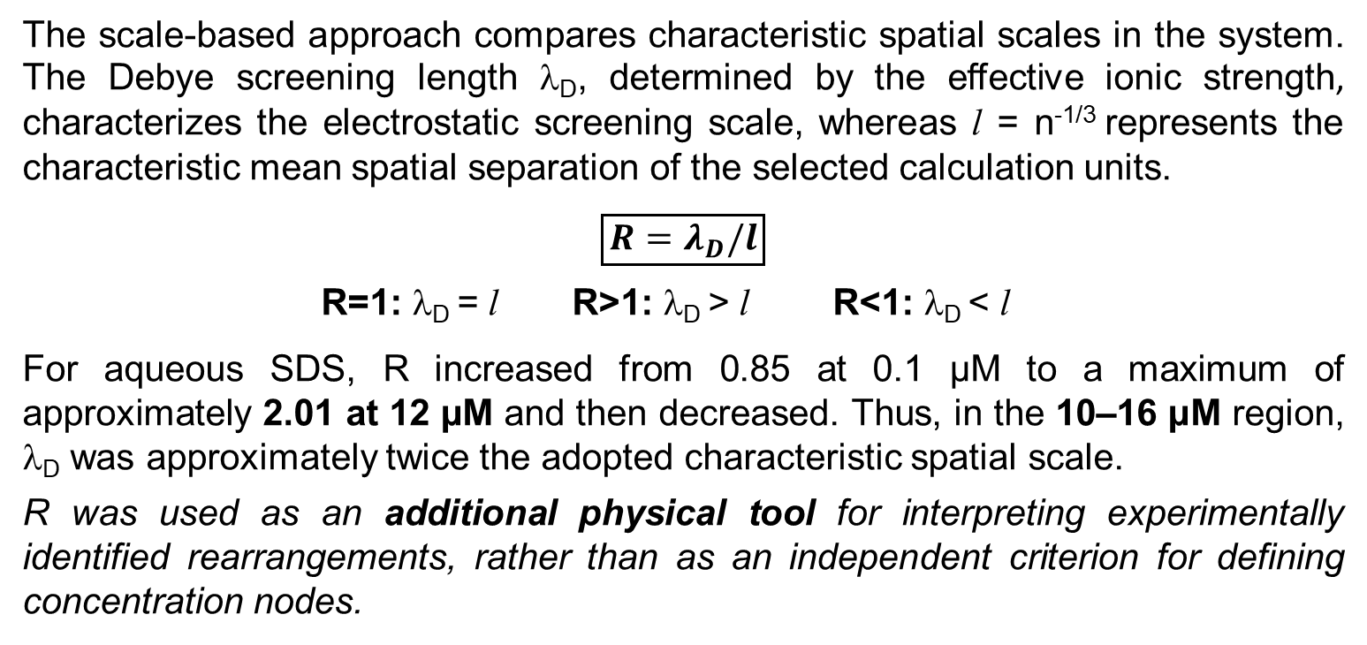
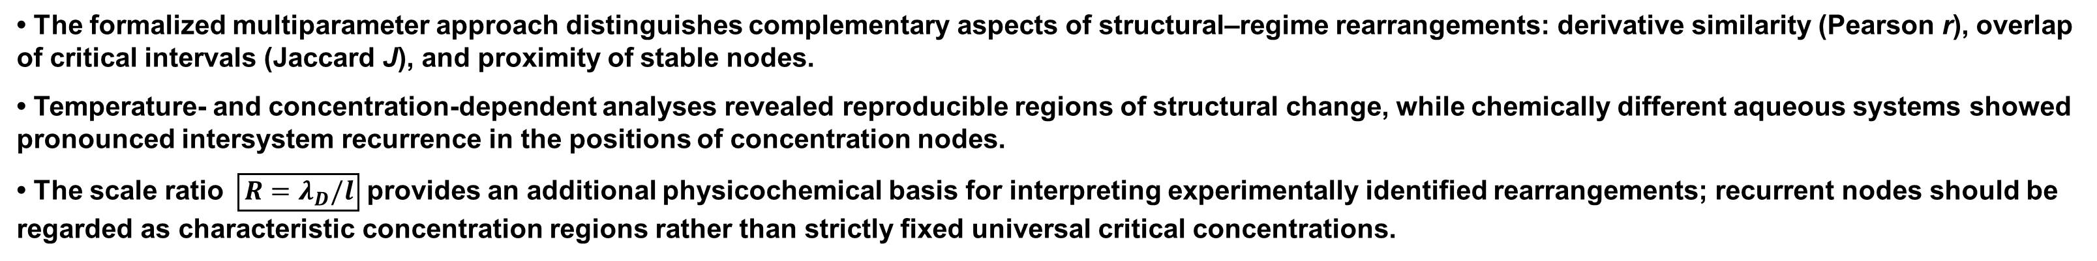
STRUCTURAL REARRANGEMENTS AND INTERSYSTEM RECURRENCE OF CONCENTRATION NODES IN AQUEOUS SYSTEMS: A FORMALIZED MULTIPARAMETER APPROACH
S.O. Dolenko
A.V. Dumansky Institute of Colloid Chemistry and Water Chemistry, National Academy of Sciences of Ukraine
42 Academician Vernadsky Blvd., Kyiv 03680, Ukraine; e-mail: sdolenko@ukr.net
BACKGROUND
AIM
Aqueous systems exhibit nonlinear changes in structural and physicochemical parameters with temperature and concentration. Such changes may be weak, distributed, or overlapping, making characteristic rearrangement regions difficult to identify from individual dependences. Their recurrence across chemically different systems may indicate common concentration-dependent features of aqueous-system organization.
To develop and test a formalized multiparameter approach for identifying structural rearrangements in aqueous systems and to evaluate the intersystem recurrence of characteristic concentration nodes.
TEMPERATURE-INDUCED REARRANGEMENTS
EXPERIMENTAL DATA
DLS • SALS
pH • Eh
PROCESSING
Replicates
Interpolation
Smoothing
PERCENTILE THRESHOLDS
PEARSON r
response similarity
DERIVATIVE ANALYSIS
dX/dT
dX/dlgC
CRITICAL INTERVALS
LOCAL EXTREMA
JACCARD J
interval overlap
GRID STABILITY
ΔlgC = 0.10, 0.15, 0.20
score ≥ 2
STABLE NODES
NODE MATCHING
localization proximity
Characteristic temperatures: 23, 31, 37 and 43–44 °C.
Derivative agreement: r = 0.753; J = 0.750 (threshold = 0.8).
Closely located extrema of the DLS derivatives identify common regions of intensive temperature-induced structural change.
CONCENTRATION-INDUCED REARRANGEMENTS
The scale-based approach compares characteristic spatial scales in the system. The Debye screening length λ_{D}, determined by the effective ionic strength, characterizes the electrostatic screening scale, whereas l = n^{-1/3} represents the characteristic mean spatial separation of the selected calculation units.
$$\boxed{R=λ_{D}/l}$$
R=1: λ_{D} = l R>1: λ_{D} > l R<1: λ_{D} < l
For aqueous SDS, R increased from 0.85 at 0.1 μM to a maximum of approximately 2.01 at 12 μM and then decreased. Thus, in the 10–16 μM region, λ_{D} was approximately twice the adopted characteristic spatial scale.
R was used as an additional physical tool for interpreting experimentally identified rearrangements, rather than as an independent criterion for defining concentration nodes.
SDS: 13 stable SALS nodes were identified for d, including 12 reproduced on all three computational grids.
Scale–structure correspondence: 5 of 6 stable dR/dlgC nodes had a SALS node within |ΔlgC| ≤ 0.15; mean |ΔlgC| ≈ 0.07.
All five matched pairs showed opposite extremum types.
INTERSYSTEM RECURRENCE OF CONCENTRATION NODES
Stable SALS nodes identified from \(d(d)/d\lg C\) and \(dN/d\lg C\) were compared across chemically different aqueous systems. Nodes with close logarithmic coordinates were grouped into characteristic concentration regions.
Detection frequency was calculated only for systems in which a given concentration region was experimentally accessible; each system was counted once.
KEY FINDINGS
0.74–1.17 μM: nodes occurred in 7/7 systems (100%) covering this region.
126–200 μM: the most representative region — 12/13 systems (92.3%).
Millimolar recurrence: 9/13 systems at 2.2–3.2 mM, 8/9 at 10–16 mM, and 7/9 at 22–32 mM.
The recurrence concerned primarily the position of the rearrangement region, rather than the direction or type of a particular SALS response.
The recurrent concentration regions were additionally compared with changes in the scale ratio $\boxed{R=λ_{D}/l}$, providing a physicochemical context for the experimentally identified nodes.
CONCLUSIONS
• The formalized multiparameter approach distinguishes complementary aspects of structural–regime rearrangements: derivative similarity (Pearson r), overlap of critical intervals (Jaccard J), and proximity of stable nodes.
• Temperature- and concentration-dependent analyses revealed reproducible regions of structural change, while chemically different aqueous systems showed pronounced intersystem recurrence in the positions of concentration nodes.
• The scale ratio $\boxed{R=λ_{D}/l}$ provides an additional physicochemical basis for interpreting experimentally identified rearrangements; recurrent nodes should be regarded as characteristic concentration regions rather than strictly fixed universal critical concentrations.

